Slide 1
IMS2024 Workshop Presentation Guidelines

Slide 2
Purpose of this Presentation
This presentation contains recommended guidelines for electronic slide preparation and provides an electronic template
The file you are reading has settings, colors, and fonts that make it easy to read
You may edit this file and replace our slides with your presentation

Slide 3
Setting up the logo(s)
If your workshop is co-sponsored by ARFTG and IMS, go to the Slide Master, delete the “RFIC” logo, and shift the “ARTFG” logo to the right, next to the “Washington DC” logo.
If your workshop is co-sponsored by RFIC and IMS (Washington DC), go to the Slide Master, delete the “ARFTG” logo.
If your workshop is sponsored by “IMS (Washington DC)” only, go to the Slide Master, delete both the “ARFTG” and “RFIC” logos.
The “Washington DC” logo must appear on all presentations.
Save your new Master.

Slide 4
5G mm-Wave Power Amplifiers, Transmitters, Beamforming Techniques and Massive MIMO
Affiliation logos allowed only on title slide
Example
WM1
¹ Patrick Reynaert, ²Leon van den Oever, and ³Ping Gui
¹KU Leuven, ² Qualcomm, ³SMU university

Slide 5
How to Use
Use the provided templates and recommended fonts and sizes

Slide 6
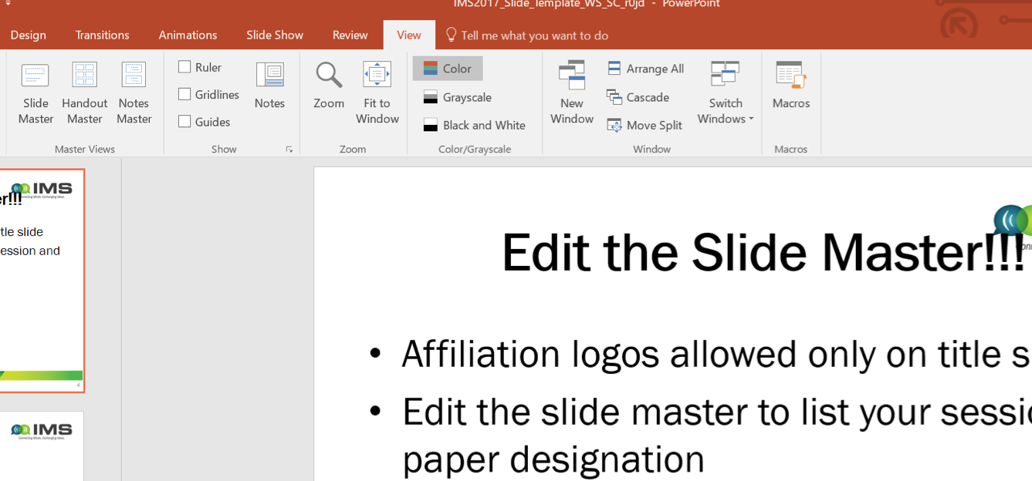
Edit the Slide Master
Edit the slide master to list your WS ID
For example, WSC-1
WSC-1

Slide 7
Make sure you have the slide #
The slide # is at the bottom of the slide between the WS ID and Denver logo
Slide numbers help guests refer to them later
Insert slide # if they get deleted

Slide 8
Typical Presentation Flow
Title slide
Introduction / Motivation / Problem or Challenge
Details of work
State how your results compare to other reported work
Conclusion slide
Backup slides if desired

Slide 9
Style Guidelines
Use short phrases, not long sentences
Use Calibri (or similar) sans serif font
This line uses Helvetica 24 pt
This is Calibri 24 pt
This line uses Arial
28 Point or larger for titles
This font is 16 pt. If you use fonts that are smaller than 18 pt, people in the back of the room may not be able to read your slide.

Slide 10
Special Fonts or Symbols
Watch out for:
Wingdings
MS line draw
Monotype sorts
Symbol fonts
Asian language fonts
Please embed TrueType fonts

Slide 11
Style Guidelines (Cont.)
The targeted time for one slide is 1 to 2 minutes
Each slide should have a title
Limit ~ 9 lines of text
Limit ~ 7 words per line
Slides sized for “On Screen Show”

Slide 12
Contrast
Choose high contrast font colors
Use dark lines/text on a light background
Foreground: Black, Blue, Red
Background: White
Caution: yellow, grey or cyan lettering and lines may be unreadable when projected

Slide 13
Display Speed
Slides should display without delay
Do not distract the audience with any transition effects
Avoid the use of slow graphics, fonts, and special effects
Do not use sound effects

Slide 14
Diagrams
Keep diagrams
Simple
Easy to view
Make all texts readable by using large fonts
Use all the available space
Do not use borders

Slide 15
Graphs
Use graphs and avoid tables if possible
Keep graphs simple
Eliminate or subdue distracting grid lines
Use large font sizes including axes labels
You do not need to apologize for presenting an “eye chart” if you do not present one.

